Slide 1
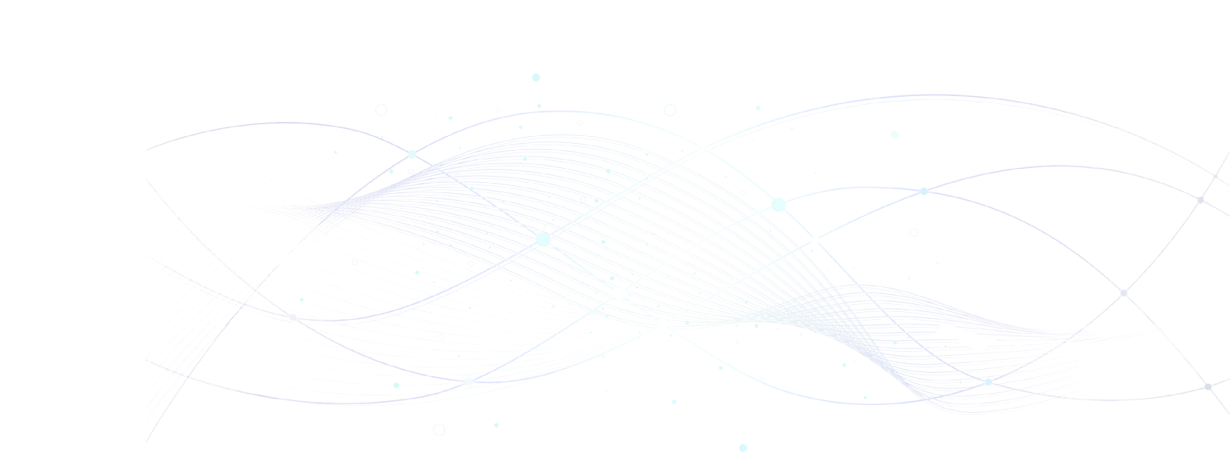




Brand Identity &
Guidelines
Project Name: Kalamna
Product: Egyptian AI Customer Support Assistant
Kalamna Brand Guidelines
2025

Slide 2
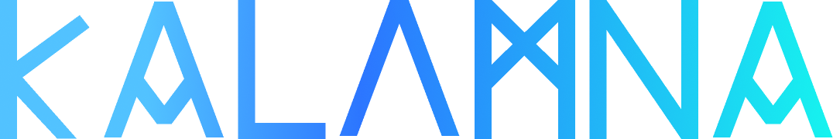
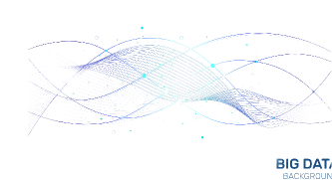
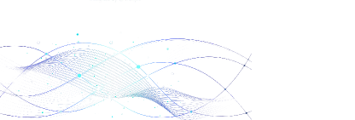
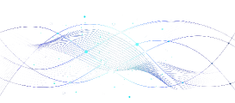
2025
UNDERSTANDS YOUR CUSTOMERS AS WELL AS YOU DO
Kalamna Brand Guidelines
Logo
02

Slide 3












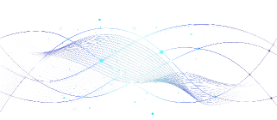

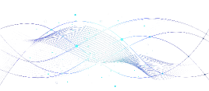
2025
UNDERSTANDS YOUR CUSTOMERS AS WELL AS YOU DO
Kalamna Brand Guidelines
Logo - light
03

Slide 4
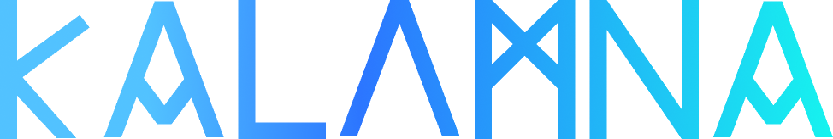



2025
Logo Concept
The logo combines the spirit of ancient Egyptian heritage with a modern digital identity.
With a subtle data-inspired overlay runs through the letters, symbolizing the AI and technology layer that powers the project.
Each letter is inspired by hieroglyphic shapes, reflecting the idea of communication and wisdom — values rooted in ancient Egypt.
This balance between heritage and innovation represents the brand’s vision: reviving Egyptian identity through modern technology.
Kalamna Brand Guidelines
Logo concept
04

Slide 5
























Brand
White
2025
Black
Logo Color variations
The logo should be lighter on darker backgrounds and darker on lighter backgrounds with an - only black - variation
Truflation Brand Guidelines
Logo Color variations
05

Slide 6







Brand
White
2025
Black
Icon variations
The Icon should be lighter on darker backgrounds and darker on lighter backgrounds with an - only black - variation
Truflation Brand Guidelines
Icon variations
06

Slide 7
Primary
01
HEX
2C76FF
BG
02
HEX
06131D
Primary - light mode
03
HEX
095398
Bg - light mode
04
HEX
FAFAFA
Secondary - color specific
2025
05
HEX
16F3EF
Text - dark
06
HEX
9ACEFF
Colors
The color palette is designed to reflect the identity of Kalamna AI as a smart, modern, and culturally-rooted Egyptian AI chatbot.
It balances pharaonic-inspired tones with a clean, contemporary digital feel, ensuring clarity, accessibility, and trust across all interface elements.
Truflation Brand Guidelines
Colors
07

Slide 8
Text - color specific
01
HEX
00203C
Text - dark
02
HEX
CECECE
Dark
03
HEX
192631
Text - light
04
HEX
9D9D9D
Light
2025
05
HEX
3DA4FF
Light
06
HEX
4794DC
Text - dark
06
HEX
FFFFFF
Colors
Truflation Brand Guidelines
Colors
08

Slide 9
Success
01
HEX
00203C
Erorr
02
HEX
CECECE
Warning
03
HEX
192631
Disabled
04
HEX
16F3EF
Status colors
Status colors help users quickly recognize the state of a process or system action. They ensure clarity, accessibility, and consistent communication across the interface.
2025
Truflation Brand Guidelines
Colors
09

Slide 10

Dark
Light
2025
Gradients
Our secondary colors are gradients that should be used as logo main colors
Truflation Brand Guidelines
Gradients
10

Slide 11
Light Regular Medium
Semi bold
Bold
IBM Plex
sans
2025
General Use Font
Why IBM Plex Sans?
Modern & Professional: Delivers a trustworthy and contemporary brand presence.
Bilingual-Friendly: Supports seamless use with Arabic and English, ensuring a consistent user experience.
Excellent Legibility: Works perfectly for UI text, chat messages, buttons, and headings.
Versatile Weights: Allows a clear visual hierarchy across our design system.
Truflation Brand Guidelines
General Use Font
11

Slide 12
Base Value: 12
Scale: 1.25
Line height: 124
Base Value: 12
Scale: 1.25
Line height: 124
The quick brown fox jumps over the lazy dog
لقد تم توليد هذا النص من مولد النص العربى
42px
42px
The quick brown fox jumps over the lazy dog
لقد تم توليد هذا النص من مولد النص العربى
32px
32px
The quick brown fox jumps over the lazy dog
لقد تم توليد هذا النص من مولد النص العربى
28px
28px
The quick brown fox jumps over the lazy dog
لقد تم توليد هذا النص من مولد النص العربى
24px
24px
The quick brown fox jumps over the lazy dog
لقد تم توليد هذا النص من مولد النص العربى
20px
20px
The quick brown fox jumps over the lazy dog
لقد تم توليد هذا النص من مولد النص العربى
2025
16px
16px
The quick brown fox jumps over the lazy dog
لقد تم توليد هذا النص من مولد النص العربى
14px
14px
12px
The quick brown fox jumps over the lazy dog
لقد تم توليد هذا النص من مولد النص العربى
12px
Typography
Our typography scale establishes a clear visual hierarchy that enhances readability and user experience across the product. Each text level—from display headlines to small labels—has been carefully defined to maintain consistency in spacing, rhythm, and accessibility. The scale adapts across mobile and desktop screens, ensuring a coherent and intuitive communication style throughout the brand.
Truflation Brand Guidelines
Typography
12

Slide 13
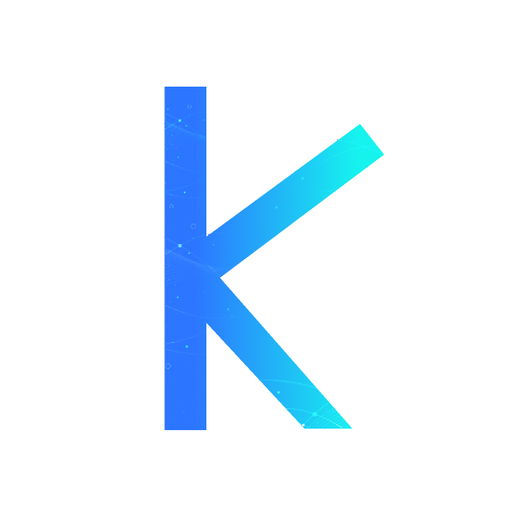
2025
Kalamna Brand Guidelines
Chatbot Widget UI
13

Slide 14
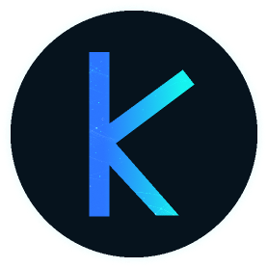
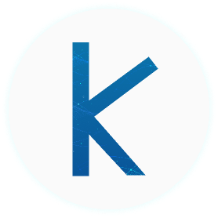
2025
Chatbot Widget UI
Our chatbot widget is designed to adapt seamlessly to different accessibility and visual comfort preferences, offering both Light and Dark interface modes.
Truflation Brand Guidelines
Chatbot Widget UI
14

Slide 15
Figma library
https://www.figma.com/design/KjukCNtC2g6CdU3yMcXyHi/Phosphor-Icons--Community-?m=auto&t=4DHq4L6zOAmkO9J4-6
Repo
https://github.com/phosphor-icons/homepage
2025
Iconography
We use Phosphor Icons, a flexible, clean, and modern icon library that supports multiple weights and styles. The icons maintain visual consistency across the interface and enhance clarity without overwhelming the design.
Truflation Brand Guidelines
Iconography
15

